Slide 1
ENEL 419 Counting Methods Tutorial Examples
September 26, 2023

Slide 2
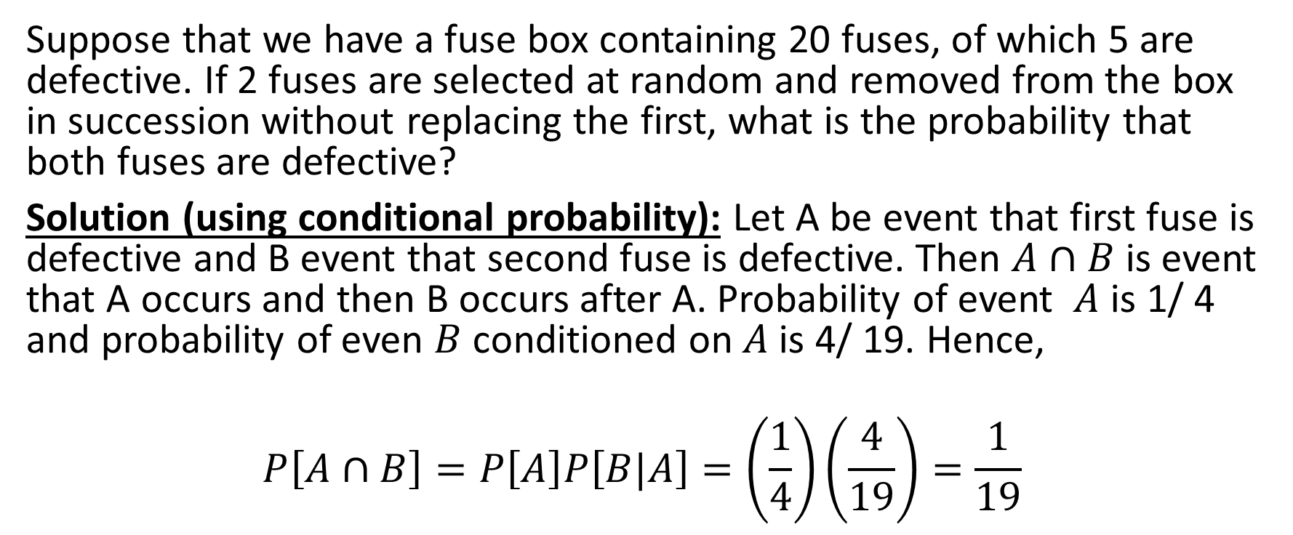
Example 1
Suppose that we have a fuse box containing 20 fuses, of which 5 are defective. If 2 fuses are selected at random and removed from the box in succession without replacing the first, what is the probability that both fuses are defective?
Solution (using conditional probability): Let A be event that first fuse is defective and B event that second fuse is defective. Then $A∩B$ is event that A occurs and then B occurs after A. Probability of event $A$ is 1/ 4 and probability of even $B$conditioned on $A$is 4/ 19. Hence,
$$P\left[A∩B\right]=P\left[A\right]P\left[B|A\right]=\left(\frac{1}{4}\right)\left(\frac{4}{19}\right)=\frac{1}{19}$$

Slide 3
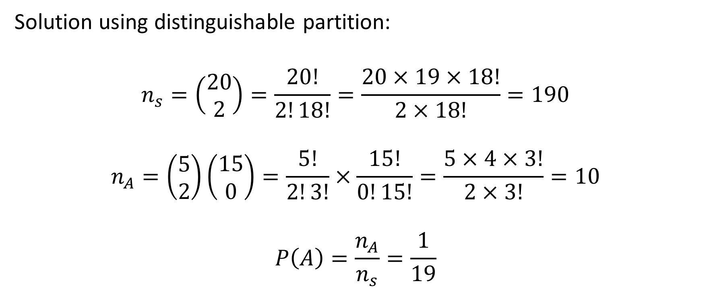
Example 1 continued
Solution using distinguishable partition:
$$n_{s}=\left(\begin{aligned}20 \\ 2\end{aligned}\right)=\frac{20!}{2!18!}=\frac{20×19×18!}{2×18!}=190$$
$$n_{A}=\left(\begin{aligned}5 \\ 2\end{aligned}\right)\left(\begin{aligned}15 \\ 0\end{aligned}\right)=\frac{5!}{2!3!}×\frac{15!}{0!15!}=\frac{5×4×3!}{2×3!}=10$$
$$P\left(A\right)=\frac{n_{A}}{n_{s}}=\frac{1}{19}$$

Slide 4
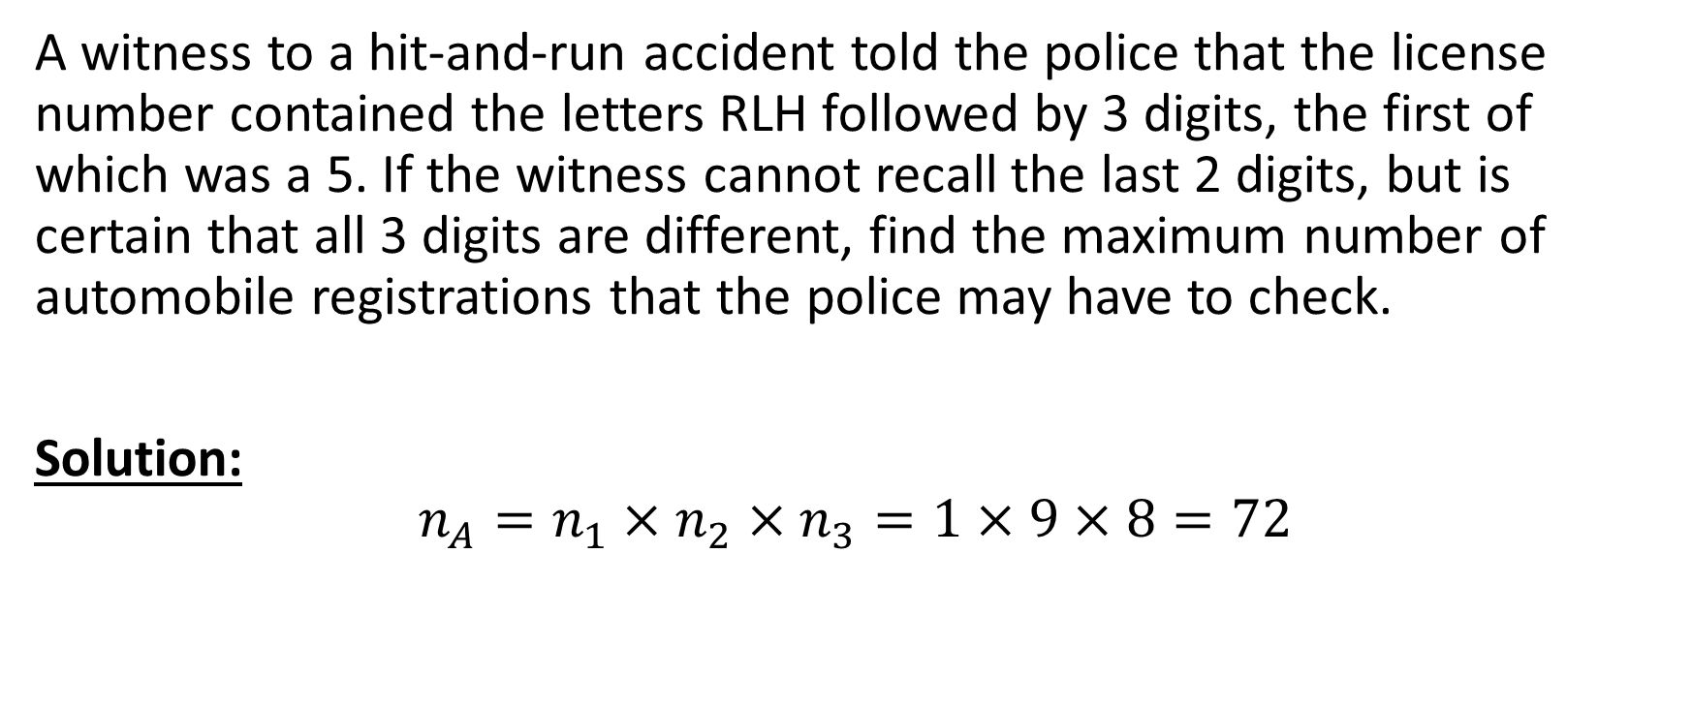
Example 2
A witness to a hit-and-run accident told the police that the license number contained the letters RLH followed by 3 digits, the first of which was a 5. If the witness cannot recall the last 2 digits, but is certain that all 3 digits are different, find the maximum number of automobile registrations that the police may have to check.
Solution:
$$n_{A}=n_{1}×n_{2}×n_{3}=1×9×8=72$$

Slide 5
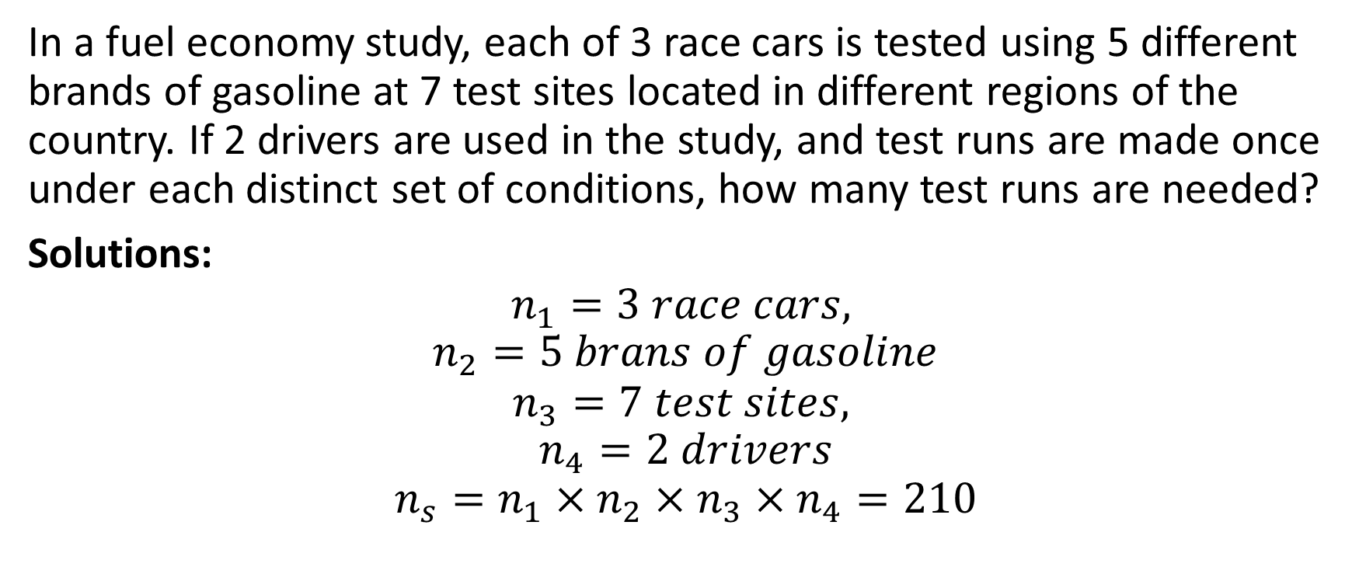
Problem 3
In a fuel economy study, each of 3 race cars is tested using 5 different brands of gasoline at 7 test sites located in different regions of the country. If 2 drivers are used in the study, and test runs are made once under each distinct set of conditions, how many test runs are needed?
Solutions:
$$n_{1}=3 race cars,$$
$$n_{2}=5 brans of gasoline$$
$$n_{3}=7 test sites,$$
$$n_{4}=2 drivers$$
$$n_{s}=n_{1}×n_{2}×n_{3}×n_{4}=210$$

Slide 6
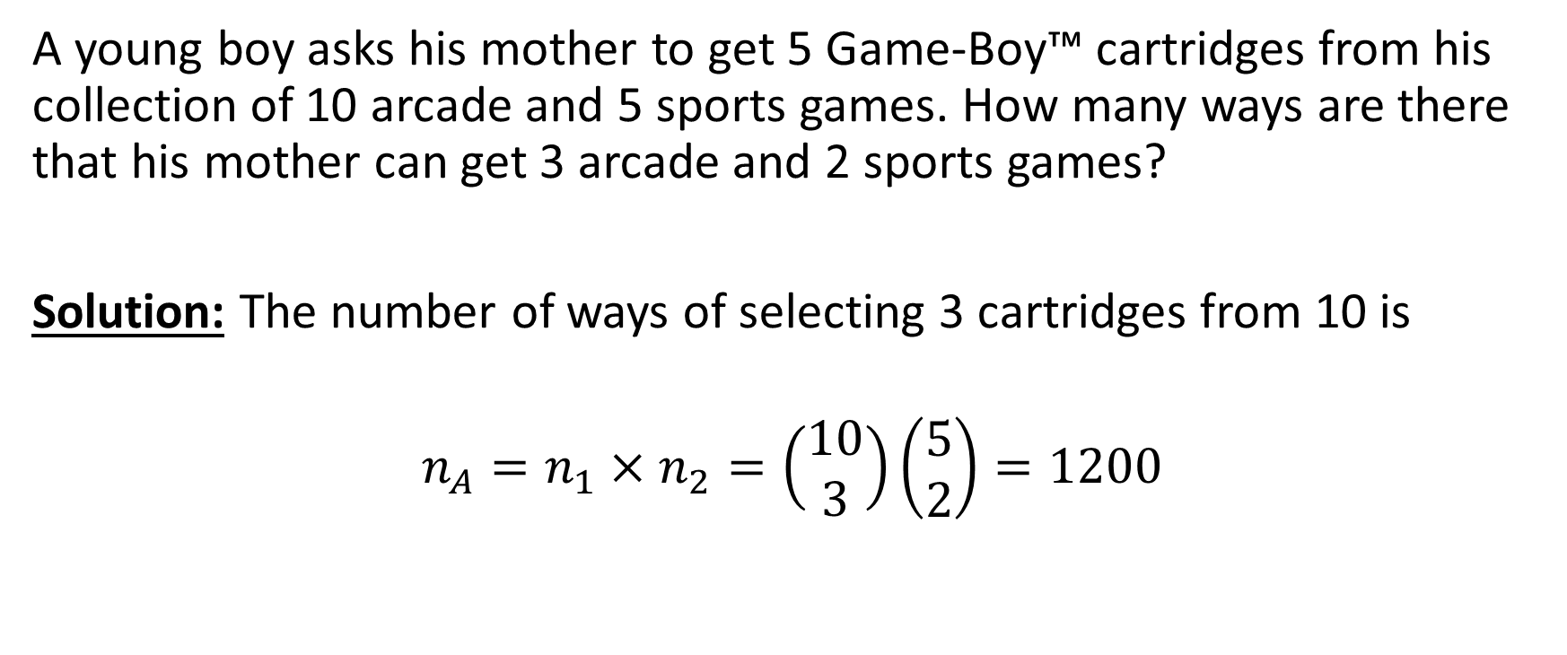
Example 4
A young boy asks his mother to get 5 Game-Boy™ cartridges from his collection of 10 arcade and 5 sports games. How many ways are there that his mother can get 3 arcade and 2 sports games?
Solution: The number of ways of selecting 3 cartridges from 10 is
$$n_{A}=n_{1}×n_{2}=\left(\begin{aligned}10 \\ 3\end{aligned}\right)\left(\begin{aligned}5 \\ 2\end{aligned}\right)=1200$$

Slide 7
Example 5

Slide 8
Example 5 Continued

Slide 9
Example 5 Continued

Slide 10
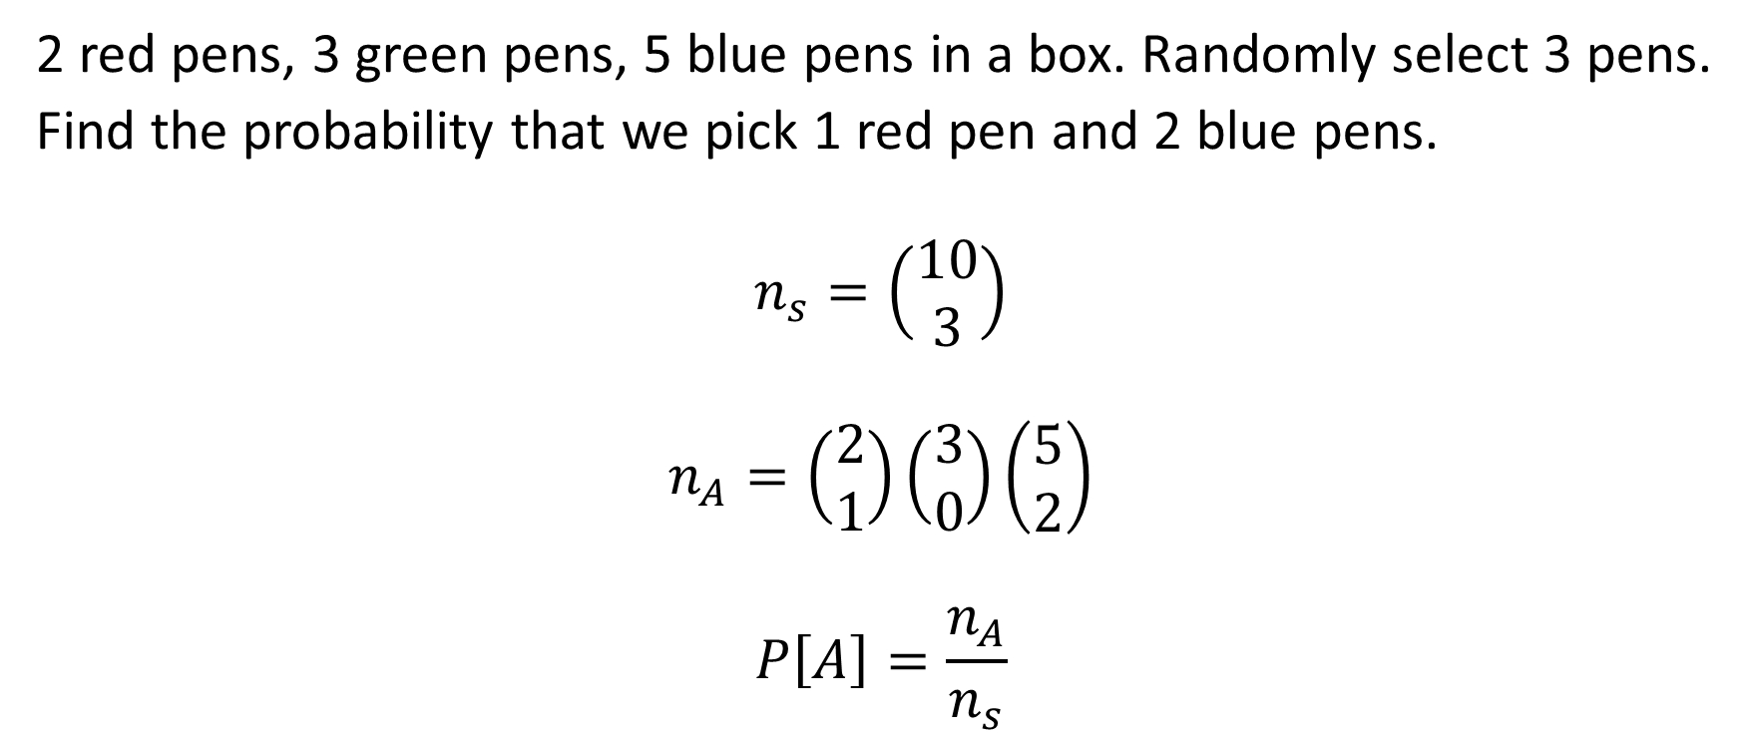
Example 6
2 red pens, 3 green pens, 5 blue pens in a box. Randomly select 3 pens.
Find the probability that we pick 1 red pen and 2 blue pens.
$$n_{s}=\left(\begin{aligned}10 \\ 3\end{aligned}\right)$$
$$n_{A}=\left(\begin{aligned}2 \\ 1\end{aligned}\right)\left(\begin{aligned}3 \\ 0\end{aligned}\right)\left(\begin{aligned}5 \\ 2\end{aligned}\right)$$
$$P\left[A\right]=\frac{n_{A}}{n_{s}}$$

Slide 11
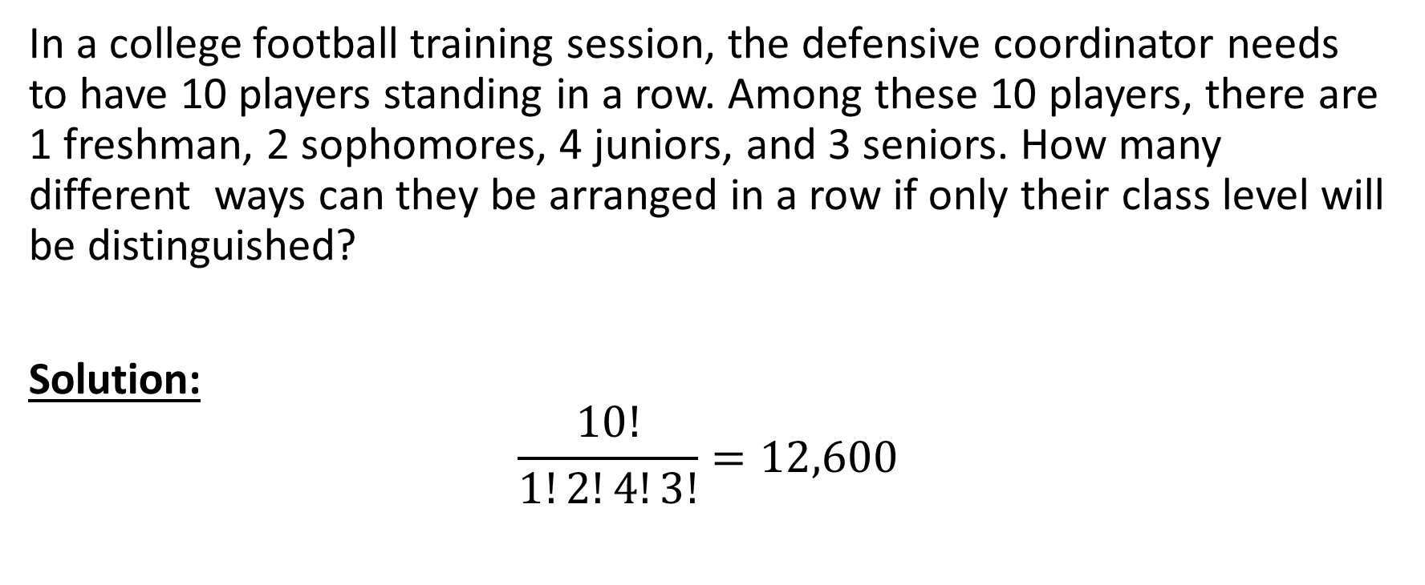
Example 7
In a college football training session, the defensive coordinator needs to have 10 players standing in a row. Among these 10 players, there are 1 freshman, 2 sophomores, 4 juniors, and 3 seniors. How many different ways can they be arranged in a row if only their class level will be distinguished?
Solution:
$$\frac{10!}{1!2!4!3!}=12,600$$

Slide 12
Example 8

Slide 13
Example 8 Continued

Slide 14
Example 8 Continued

Slide 15
Example 9
A president and a treasurer are to be chosen from a student club consisting of 50 people. Find how many different choices of officers are possible if
(a) There are no restrictions.
(b) One, say A, will serve only if he/she is president.
(c) Two, say A and B, will only serve together, otherwise, they will not serve at all.
(d) Two, E and F will not serve together; otherwise, they will serve.

Slide 16
Example 9 Continued

Slide 17
Example 9 Continued

